Slide 1


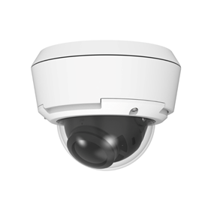
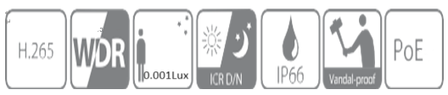
-
EL-CD500(5MP)
Sony Starvis 5MP Vandal Dome Camera
Sony Starvis1/2.8” 5Megapixel CMOS
(SONY IMX 335)
2.8~12mm Motorized Lens
Support Multi Streaming & Codec
Max. 30fps@ 2592(H) x 1944(V)
Support PoE, DC12V
IP66
System Overview
Sony Starvis CMOS (IMX 335) 탑재에 따른 저조도 및 색감의 차이가 월등하며, WDR, 방수 IP66 등급, 다양한 원격 브라우저를 지원함. 순수 국내 생산 제품임 (Made in Korea) Functions - 이미지 센서 Sony CMOS 탑재에 따라, 중국산 Smart Sensor와 영상 화질, 색감 등의 차이가 큼 - 다양한 압축방식 지원 및 멀티 스트리밍 지원 H.265/H.264/MJPEG 등 멀티 코덱 지원 - 보안 관련 WS-Security, RTSP Access Control 지원 - 원격 브라우저 지원 I/E, Safari, Chrome 등 이용 가능 - 공공기관TTA 인증 및 Korea Make 국내산 제조 및 관리를 통한 품질 확보 및 TTA 인증 보유
4F, 2-dong,234, Saneop-ro 155beon-gil, Gwonseon-gu, Suwon-si, Gyeonggi-do, Republic of Korea
Tel : 031-257-7157 / Fax : 031-257-7159
E-mail : elimopt@elimopt.co.kr / Web : http://www.elimopt.co.kr/

Slide 2
-
EL-CD500
Camera
Image sensor | Sony 1/2.8" Starvis CMOS 5MP Sensor (IMX335)
Number of Effective Pixel | 2592(H) x 1944(V) 5Megapixels
Min. illumination | 0.001 Lux
AWB | Auto / Manual/ATW
Slow shutter | Auto/Off
WDR | On / Off
BLC | On / Off
3DNR | Auto
Shutter Speed | Auto / Manual (1/30 ~ 1/30,000 Sec)
AGC | Auto
Day & Night | Auto / Color / BW
Image Effiect | Mirror, Flip
Motion Detection | Yes
Privacy Mask | 4 Blocks (On / Off)
Video
Video compression | Simultaneous Multi Codec (H.265 / H.264 / MJPEG)
Resolution | Max. 30fps@ 2592(H) x 1944(V)
Triple-Stream | Main Stream(2592P), Sub-Stream(1080P), Trip-stream(320P)
Bitrate Control | CBR/VBR, Network Bandwidth Control
Network
Network Protocol | TCP/IP, HTTP, RTP/RTSP,UDP, DHCP, FTP, SMTP, NTP, ARP, ICMP, DDNS, ONViF
Connection Mode | Fixed IP, DHCP,DDNS
Max. User Access | Up to 10
Security | WS-Security, RTSP Access Control
Onvif Compliance | Yes
Remote Monitoring | All Kinds of Web Browser (I/E, Safari, Chrome, Firefox) CMS & MobileViewer (iPhone & Android)

Slide 3
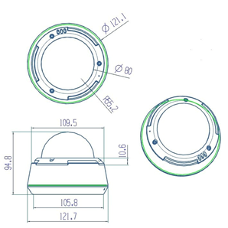




floor plan
EL-CD500
External Terminals
LAN | 10/100BaseT LAN (auto MDIX)
Factory Reset | Supported
Other | Line in / Line out / DC 12V in)
Environment
Operating Temperature / Humidity | -10℃ ~ 50℃ / Less than 90% RH
Power | DC 12V / 0.11A
floor plan

